Slide 1

MANIT INFO
A WEBSITE FOR SMART INTERACTION BETWEEN STUDENTS AND INSTITUTE.
NOTICE
LOGIN
ASSINGMENT
QUERY

Slide 2

Notice
This website is created for faster accessibility and availability of the information and data that is frequently required by the UG students of MANIT. This aims to provide more friendly interaction of institute, student council, faculty and students. This website has been developed by students of Computer Science Department.
Academics
Assignment
Query
Login

Slide 3

Why do we need this website?
?
?
?
The official website is targeted for various purposes like administrational work, students, marketing, information source etc. Thus, the official website manages a very large amount of data and information. Thus, its quite difficult to manage and is not able to deliver some important information which is frequently required and accessed by students. This website targets to fill that gap. This also provides platform to the students to interact in a much better way with college, department and administration . This website is targeted to work in a much faster way as it is managed and operated by students only which will help in much better working of website.
?
?
?
?
?
?

Slide 4

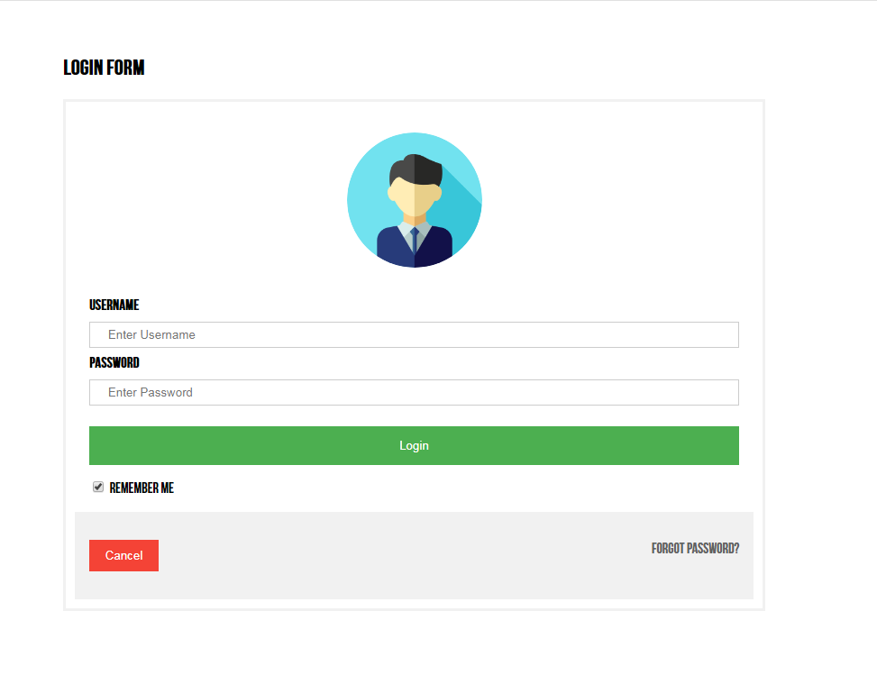
How does this website work?
This website is updated and managed by students only. They can update the website by logging in using their username and password. Members of Student Council, class representatives and only other authorized person can edit or update the information. While it can be accessed without login for faster surfing and accessing of information.
This ensures a much better way of interaction and access of information.

Slide 5

DEMONSTRATION

Slide 6

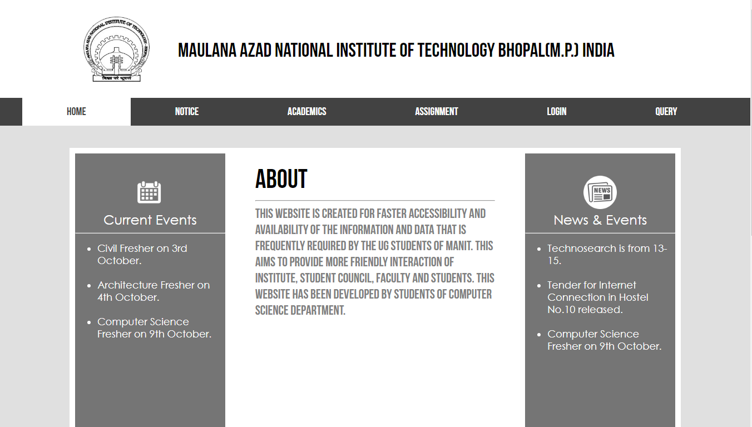
HOME PAGE
Current Events is a section where update about recent events are posted so that students are informed immediately about events.
News & Events is a section where update about recent news and activities are posted so that students are kept updated about institute.

Slide 7

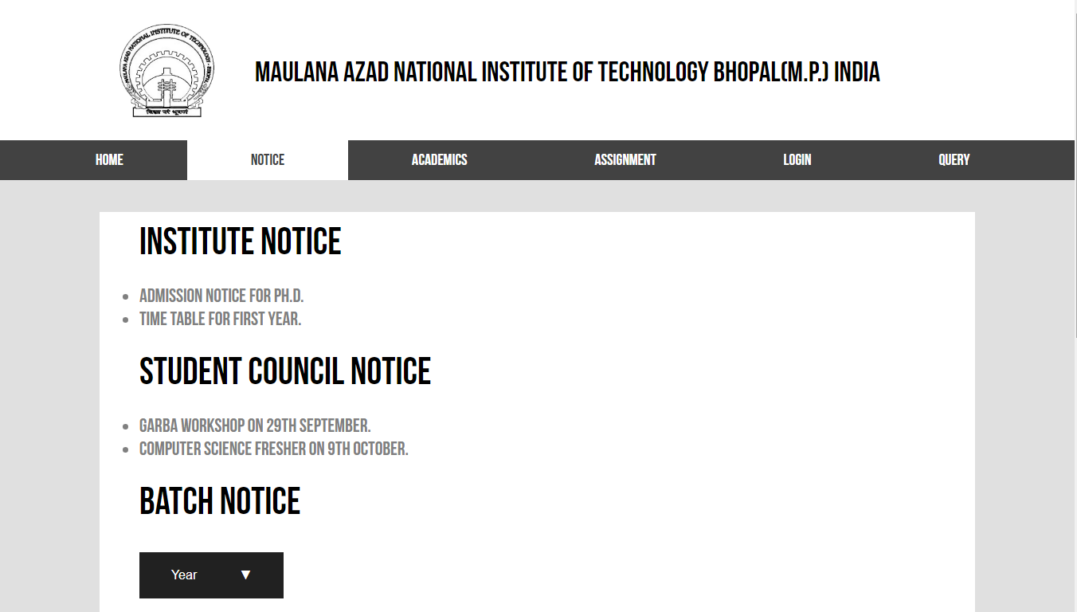
Notice PAGE
Notice Page targets for collection of all the notices that are given by various sources that should be notified to the students. Notice Page also targets for faster updating of information. Notice regarding the department, batch and various other important sections of the institute are not delivered to the students. This page also aims to solve this problem.
This section contains notices given by the Institute.
This section contains notices given by the Student Council
This section contains notices regarding the specific batches and department

Slide 8

Batch Notice
To know Notice about your batch, first choose your year.

Slide 9
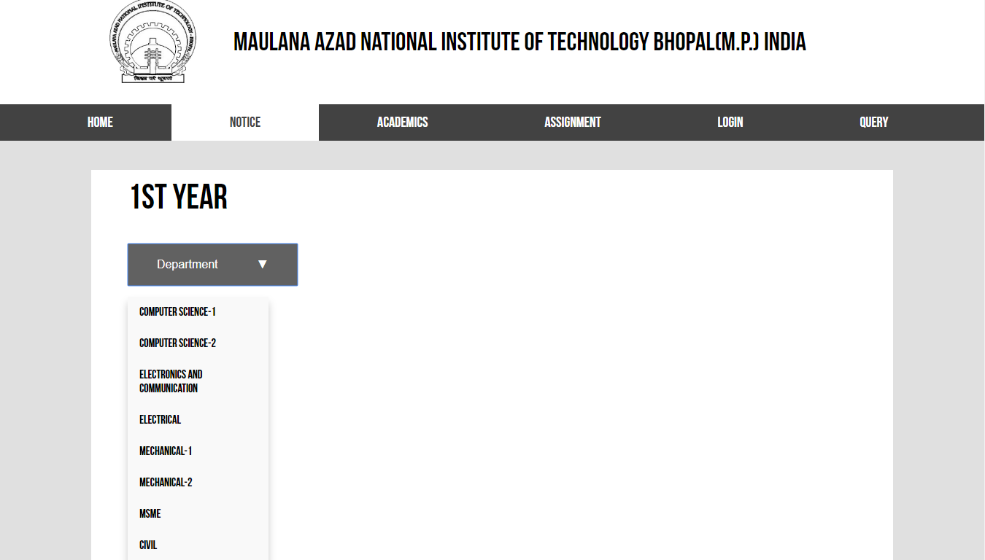
Batch Notice
After choosing year, choose your department or batch to know your notice.

Slide 10
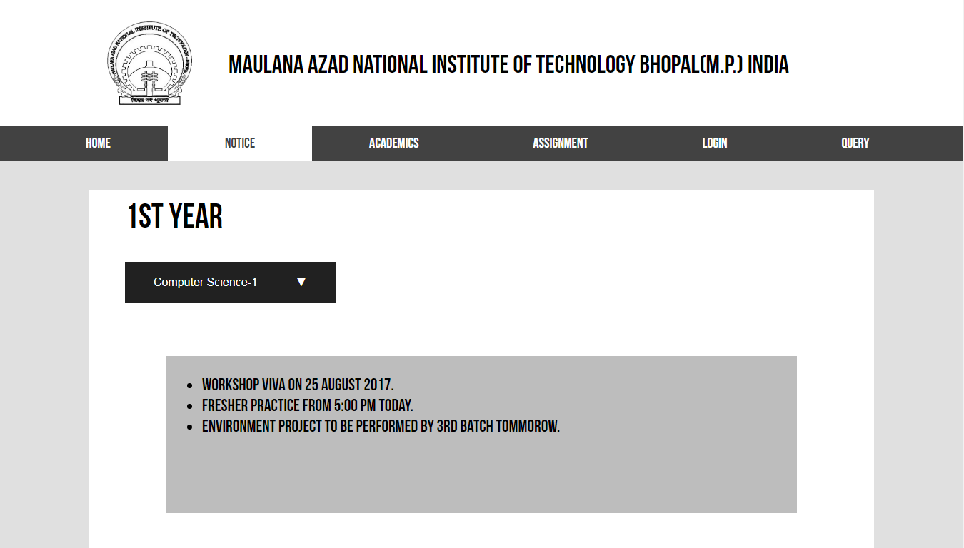
Assignment PAGE

Slide 11
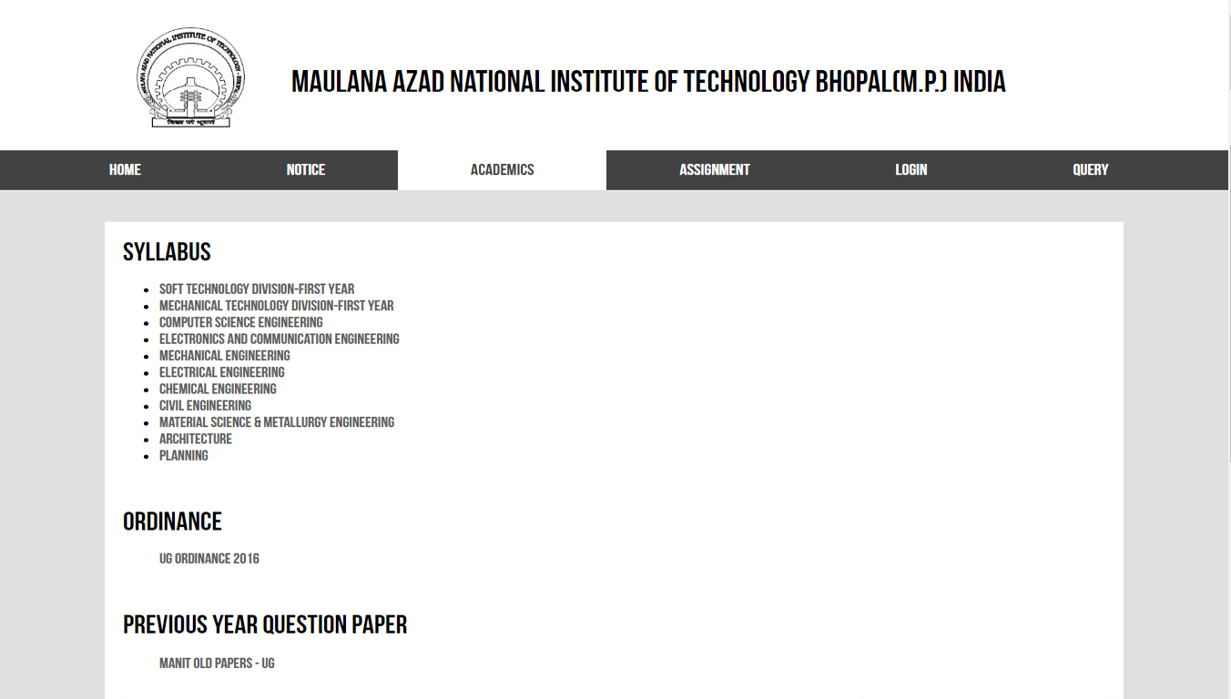
Academics PAGE
Academics Page targets for collection of all the relevant information that is demanded by the students frequently. Academics page aims to provide faster and simpler access to the information. This page includes syllabus of all the UG departments, ordinance and previous year question papers facebook page link.

Slide 12
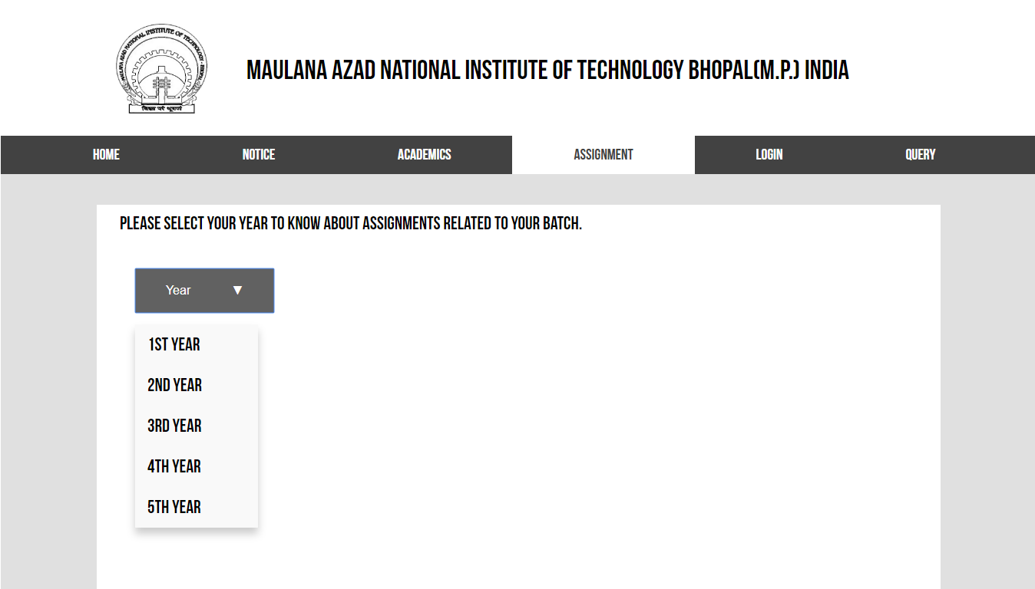
Assignment PAGE
Assignment page targets for collection of all the assignments and other projects, notes that are related with each batch. This page aims to provide a platform where all the students can find work related with their batch without any difficulty.
To know Assignment related to your batch, first choose your year.
After choosing year, select your batch

Slide 13
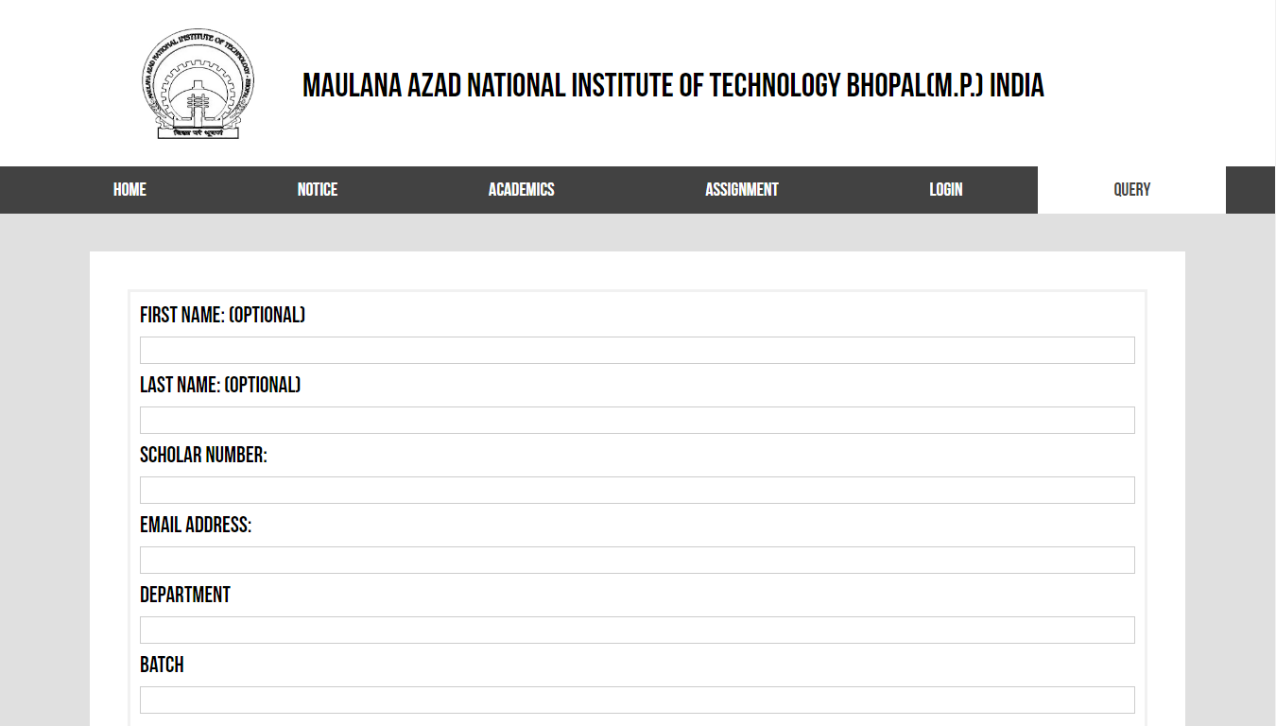
query PAGE
Query page targets for providing a platform where students can ask their doubts and they would be sent to the concerned persons. This would give a much better way to clear their doubts, queries etc. The query after being resolved will be emailed to email-id of the student.

Slide 14
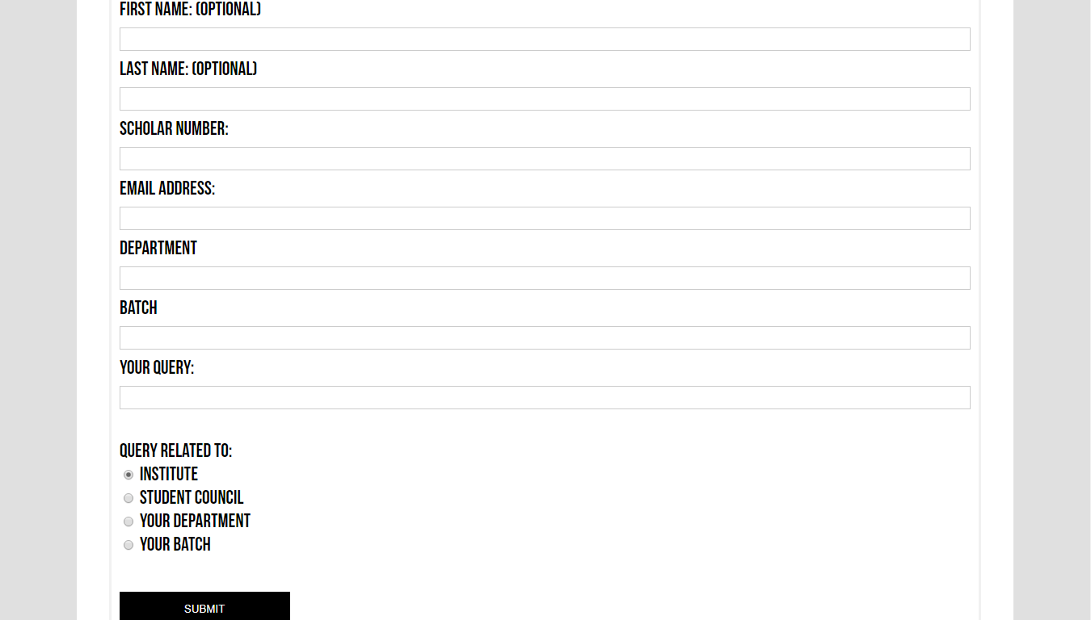
query form
This section of the form helps you to choose the concerned authority or person from which you want to ask query.
After filling the form, click Submit button to submit your query.

Slide 15
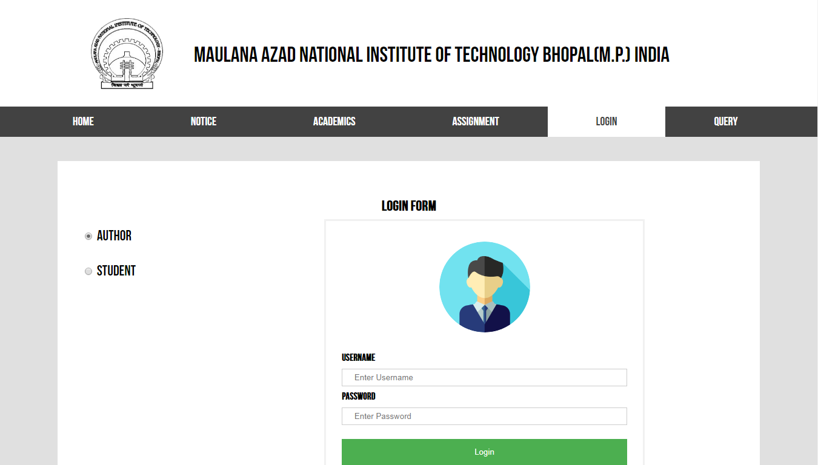
Login page
Login page serves as the backbone of the website as this page allows user to login and update or edit information present on the website. So it aims to provide access to the website to only authorized persons only to maintain accuracy of information.
This section allows us to choose whether we want to do student or author login.

Slide 16

Login form

Slide 17

Thus, this website aims to provide a smarter and efficient way of not only handling data but also delivering information to students. As this website is targeted for students only, so it contains relevant information only. Its a reliable source as it is managed by authorized persons. Thus we require this kind of website to fill the gap between students and institute.
Faster Access
Reliable Source
Informative
Interactive

Slide 18

Thank you
Created
&
Presented BY:-
Prakhar agarwal
CSE-1
I year

